Slide 1
IMAGE DENOISING USING CONVOLUTIONAL AUTOENCODERS
ISHA.R

Slide 2
AGENDA
Introduction
Problem Statement
Project Overview
End Users
Solution and Value Proposition
The Wow Factor
Modelling Approach

Slide 3
PROBLEM STATEMENT
Digital images are susceptible to noise, caused by factors such as sensor limitations and compression artifacts. This noise degrades image quality, impacting tasks like image analysis and recognition. Traditional denoising methods often blur images or remove important details along with noise, leading to suboptimal results.

Slide 4
PROJECT OVERVIEW
This project aims to tackle the challenge of image denoising by leveraging convolutional autoencoders.
Convolutional autoencoders are neural network architectures specifically designed for unsupervised feature learning and data compression.
By compressing noisy images into a lower-dimensional representation and then reconstructing them, convolutional autoencoders can effectively remove noise while preserving important image features.

Slide 5
END USERS
End users of this project include professionals and industries dealing with image processing tasks, such as:
Photographers
Graphic designers
Medical imaging professionals
Surveillance and security companies
Entertainment and media industries

Slide 6
SOURCE AND VALUE PROPOSITION
Our solution involves implementing convolutional autoencoders for image denoising.
By training the autoencoder on noisy images and their corresponding clean versions, the model learns to map noisy inputs to denoised outputs.
The value proposition lies in providing a robust and efficient tool for removing noise from images without compromising on image quality.
This leads to enhanced visual aesthetics, improved analysis accuracy, and better decision-making in various domains.

Slide 7
THE WOW FACTOR
The wow factor of our solution lies in its ability to effectively remove noise from images while preserving crucial details.
Convolutional autoencoders, with their ability to capture spatial dependencies and patterns, excel in extracting relevant image features and producing visually appealing denoised images.
Moreover, the adaptability of the model allows it to handle various types and levels of noise, making it a versatile tool for image denoising tasks.

Slide 8
MODELLING APPROACH
The modelling approach involves designing and training a convolutional autoencoder architecture using frameworks like TensorFlow/Keras.
The architecture consists of encoder and decoder networks, with convolutional layers for feature extraction and reconstruction.
The model is trained using noisy images as input and their corresponding clean versions as targets, optimizing model parameters to minimize the difference between the reconstructed and ground truth images.
Additionally, hyperparameter tuning and optimization techniques are employed to enhance the model's denoising performance.

Slide 9
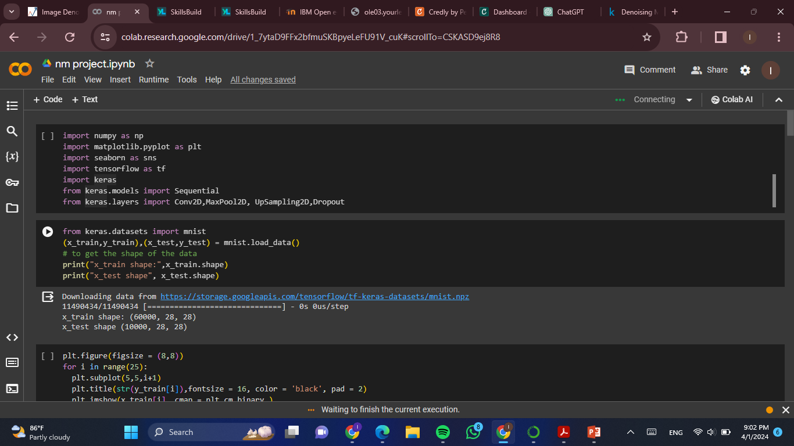
RESULTS

Slide 10
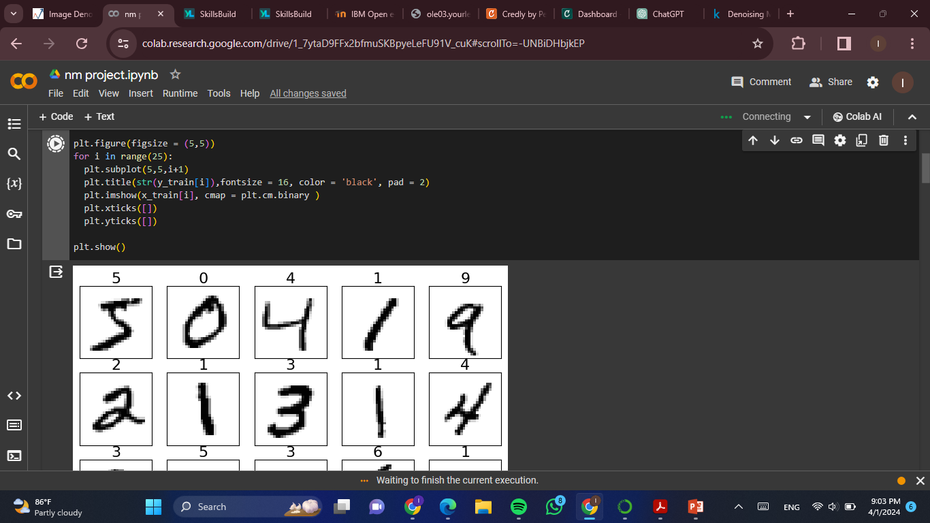

Slide 11
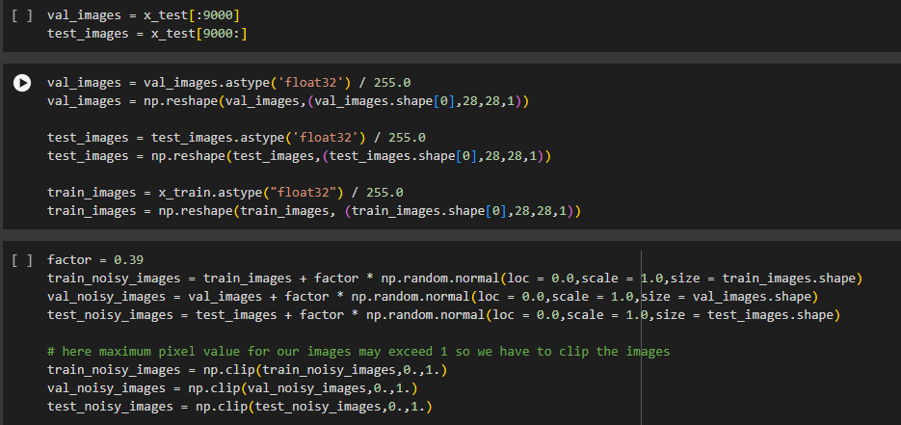

Slide 12
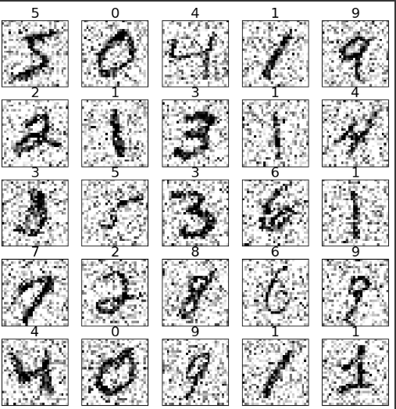
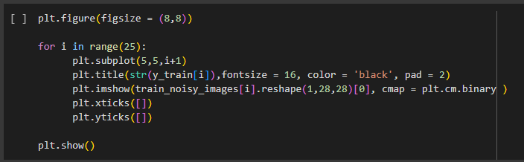

Slide 13


Slide 14
Thank You

